Slide 1
Introduction to Computer Systems
Department of Computer Science and Information Systems
Lecturer: Steve Maybank
sjmaybank@dcs.bbk.ac.uk
Spring 2020
Week 2b: Storing Integers

Slide 2
Representations of Negative Integers
Put a minus sign in front of the representation for a positive integer.
Excess notation.
Two’s Complement notation – the most popular representation for integers in computers.

Slide 3
Excess Notation
Problem: represent a set of positive and negative integers using bit strings with a fixed length n
Represent 0 by 10…0 (n bits)
Represent positive numbers by counting up from 10…0 in standard binary notation
Represent negative integers by counting down from 10…0 in standard binary notation.

Slide 4
Three Bit Excess Notation
111 3
110 2
101 1
100 0
011 -1
010 -2
001 -3
000 -4
n=3

Slide 5
Alternative Name: Excess Four Notation
111 3
110 2
101 1
100 0
011 -1
010 -2
001 -3
000 -4
bit string = Binary(number+4)
e.g.
110 = Binary(2+4)
011 = Binary(-1+4)

Slide 6
Examples
Find the 6 bit excess notation for the decimal numbers 7 and -6.
Which decimal number has the 5 bit excess notation 10101?

Slide 7
Two’s Complement Notation
$n$ bit two’s complement notation for integers $x$ in the range $−2^{n−1}≤x≤2^{n−1}−1$
$\text{TC}\left(x\right)=\text{rightmost} n \text{bits} \text{of} 2^{n}+x$
Eg. $n=4, −8≤x≤7$
$$\text{TC}\text{(3) = }\text{rightmost} 4 \text{bits} \text{of} 2^{4}+3=0011$$
$$\text{TC}\text{(−1) = }\text{rightmost}\text{ 4 }\text{bits} \text{of} 2^{4}−1=1111$$

Slide 8
More Examples

Slide 9
Example of Two’s Complement Notation
0111 7
0110 6
0101 5
0100 4
0011 3
0010 2
0001 1
0000 0
1111 -1
1110 -2
1101 -3
1100 -4
1011 -5
1010 -6
1001 -7
1000 -8
n=4
The left most bit indicates the sign.

Slide 10
Addition and Subtraction
In the two’s complement system subtraction reduces to addition.
E.g. to evaluate 6-5 in 4 bit two’s complement notation, add the tc bit strings for 6 and –5, then take the four rightmost bits.
0110 6
1011 -5
=== ==
10001 1

Slide 11
Explanation
TC(6) = rightmost four bits of Binary(2⁴+6)
TC(-5) = rightmost four bits of Binary(2⁴-5)
Binary((2⁴+6)+(2⁴-5))= Binary(2⁴+2⁴ +1).
The right most four bits of Binary(2⁴+2⁴ +1) form the bit string for TC(1).

Slide 12
Why Use Two’s Complement
Addition and subtraction require one circuit for addition and one circuit for negation.
This is more efficient than having a circuit for addition and a circuit for subtraction.

Slide 13
Notation
Let s, t be bit strings. The concatenation of s and t is s||t, e.g.
110||001 = 110001
Let s be a bit string. Then complement(s) is the bit string obtained by reversing the bits of s, e.g.
complement(110) = 001

Slide 14
Two’s Complement Notation for m and -m
Let TC(m) = s || 1 || t, where t is a string of zeros
TC(-m) = complement[s]||1||t.
Examples: n = 4,
TC(3) = 0011, TC(-3) = 1101
TC(-1) = 1111, TC(1) = 0001

Slide 15
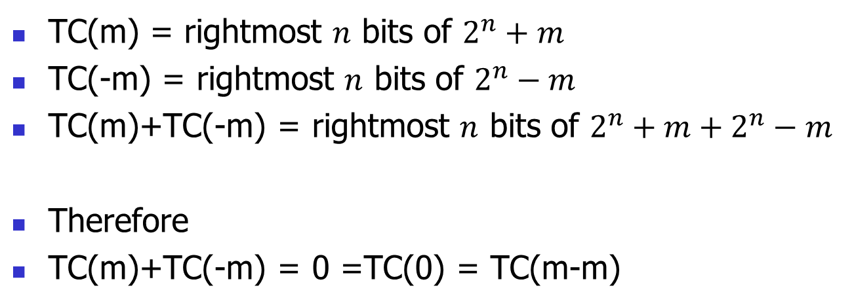
TC(m) and TC(-m)
TC(m) = rightmost $n$ bits of $2^{n}+m$
TC(-m) = rightmost $n$ bits of $2^{n}−m$
TC(m)+TC(-m) = rightmost $n$ bits of $2^{n}+m+2^{n}−m$
Therefore
TC(m)+TC(-m) = 0 =TC(0) = TC(m-m)

Slide 16
Expression for TC(-m)
Let TC(m) = s || 1 || t, where t is a string of zeros.
To prove TC(-m) = complement(s)||1||t, show that
s||1||t + complement(s)||1||t = 0
t+t = t = string of zeros
1+1 = 0+carry
s+complement(s) = string of ones
carry+string of ones = 10…0
The rightmost n bits are all zero.

Slide 17
Alternative Expression
TC(-m) = complement(TC(m))+1
Proof: let r be a string of 1s with the same length as t. Then
complement(s||1||t)+1=(complement(s)||0||r)+1
= complement(s)||1||t

Slide 18
Two’s Complement and Subtraction
$$\text{TC}\left(x−y\right)=2^{n}+x−y=2^{n}+x+2^{n}−y$$
$$=\text{TC}\left(x\right)+\text{TC}(−y)$$
(correct for the rightmost n bits only)
Subtraction can be carried out using addition
and the two’s complement notation TC. This
reduces the complexity of the circuits required
for arithmetic

Slide 19
Example
Find the 5 bit two’s complement representations for the decimal integers 5 and -5.

